Slide 1

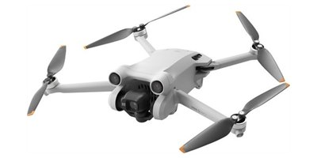
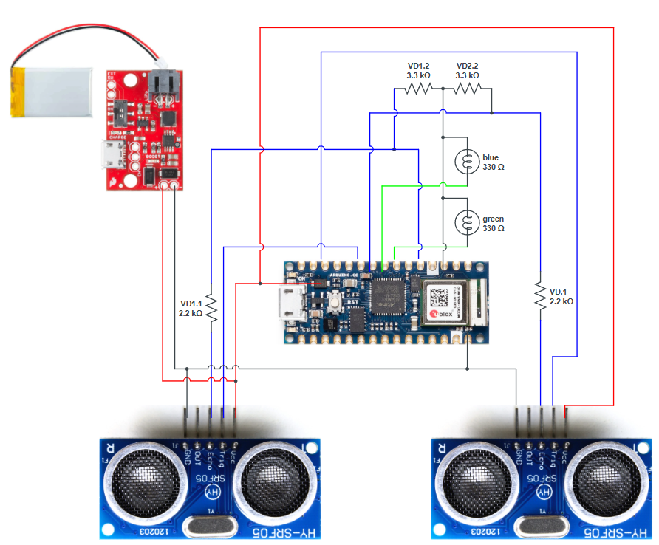
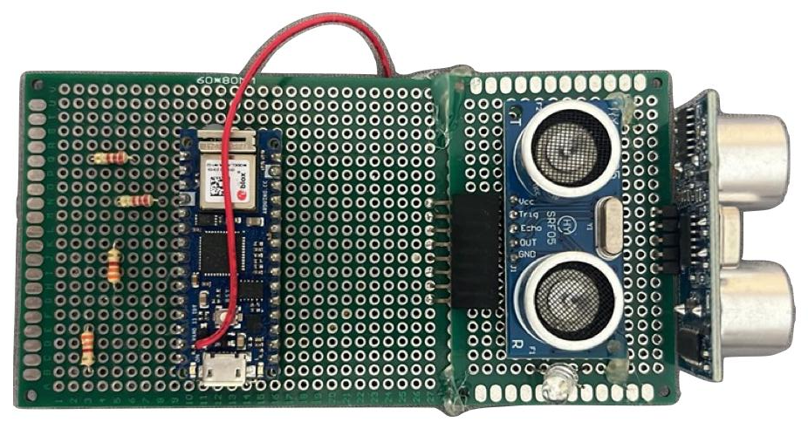
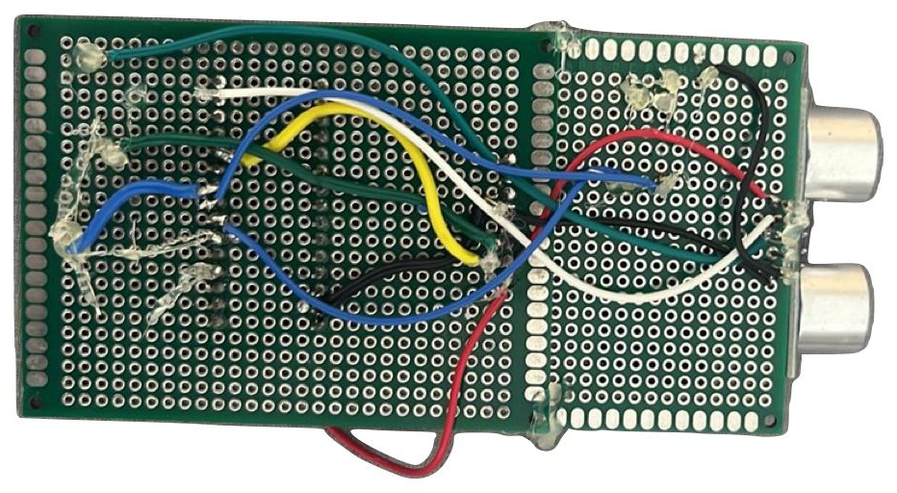
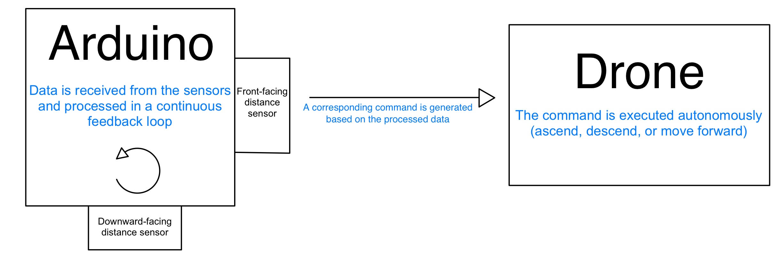
Autonomous Drone for Stairs Detection and Navigation
Project Number: 24-1-1-2735
Names: Alina Lojkin & Shely Benbenishti
Advisor: Prof. Dan Feldman
Introduction In recent years, drones have become essential tools in various industries, including surveillance, search and rescue, mapping, and research. However, navigating indoor or irregular environments remains a significant challenge- especially when it comes to detecting and overcoming vertical obstacles like stairs, that are difficult for both ground-based and aerial systems. Our project addresses this challenge by developing a lightweight, low-cost, fully autonomous drone capable of detecting and crossing stairs using simple yet effective sensors. The system relies on real-time data processing to guide the drone, enabling efficient navigation in structured environments such as buildings, where stairs often interrupt standard flight paths. Motivation The motivation behind this project is to explore how lightweight sensing and control systems can be integrated into compact drones to enable intelligent and autonomous behavior in complex indoor spaces. Implementation The drone advances in a straight line while continuously receiving data from the ultrasonic sensors. Once a stair is detected, the system processes the data in real time and issues a command for the drone to ascend, bypass the obstacle, and resume forward motion. This cycle repeats autonomously, allowing the drone to navigate a series of stairs without external control. | The project was divided into two main components: hardware and software. Hardware: We used a DJI Mini Pro 3 drone as the flight platform. A custom-built system was mounted on the drone, consisting of two ultrasonic sensors connected to an Arduino Nano 33 IoT. The setup also includes a lithium battery connected to a SparkFun 5V/1A LiPo Charger/Booster, along with an indicator LED — all soldered and assembled independently. Software: The Arduino board runs a C++ code that reads distance measurements from the ultrasonic sensors in a live feedback loop. This data is transmitted to a Python script running externally, which processes the information and determines the drone's relative position and situation based on the sensor readings. It then sends the appropriate flight commands through the OpenDJI SDK, guiding the drone on how to proceed. | Results To evaluate the system's performance, we tested the drone’s ability to detect and respond to stairs using real-world measurements. The results are presented in the following graphs showing stair detection accuracy and flight response consistency. Conclusions The project demonstrates that a simple, low-cost hardware system can enable fully autonomous drone behavior in structured indoor environments. By using only ultrasonic sensors and basic logic, the drone successfully detects stairs and responds with appropriate movement commands. This confirms that accurate stair traversal can be achieved without relying on heavy processing or advanced visual systems.

